Slide 1
Interactive Visual
Data Analysis
05 – Multivariate visualization

Slide 2
Objectives
How can we visualize data with multiple variables: Learn basic visualization techniques for multivariate data

Slide 3
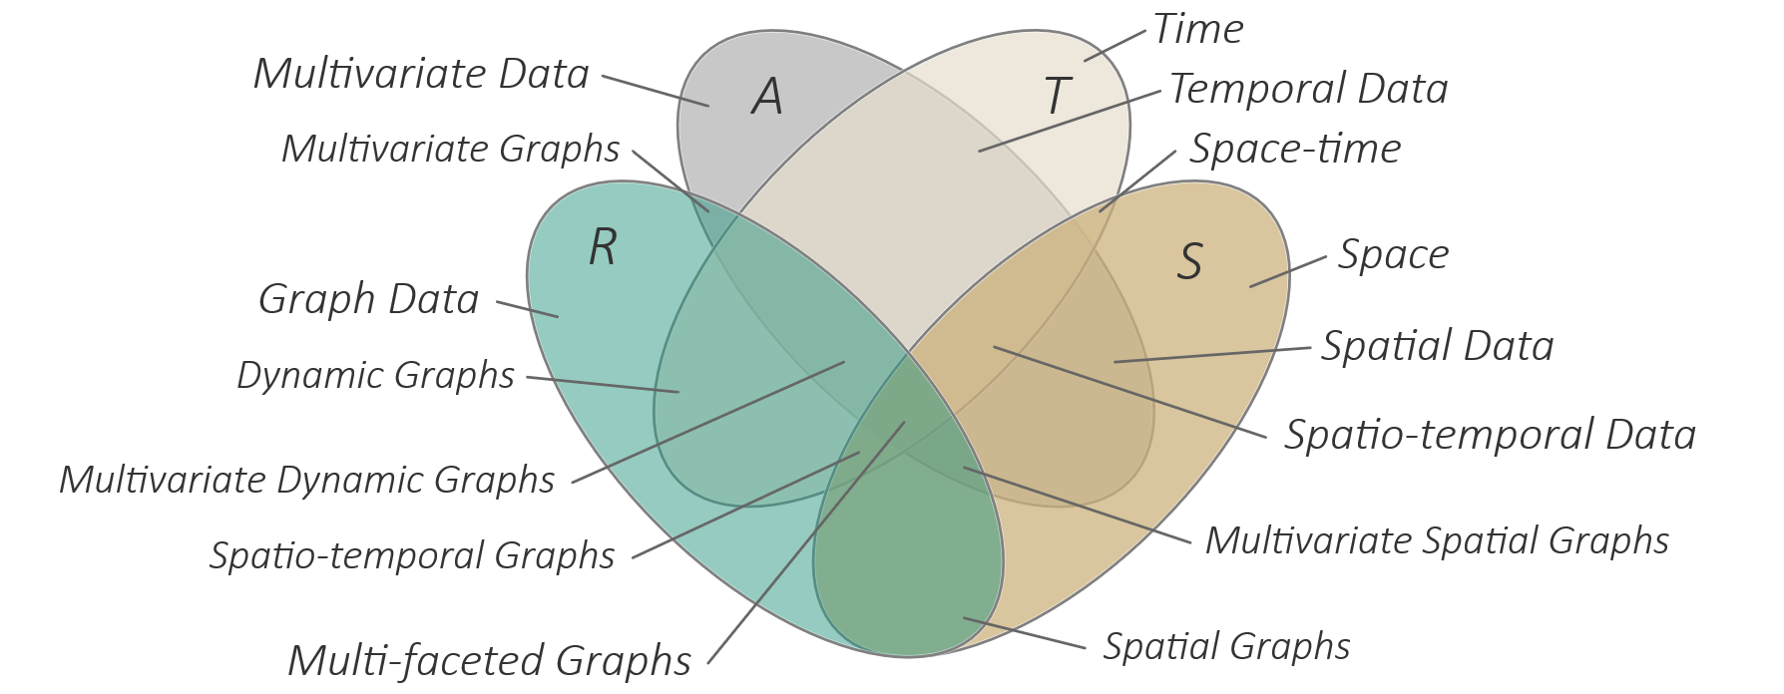
Overview
Visualization techniques for multivariate data
  Table-based visualizations
  Combined bi-variate visualizations
  Polyline-based visualizations
  Glyph-based visualizations
  Pixel-based visualizations
  Nested visualizations

Slide 4
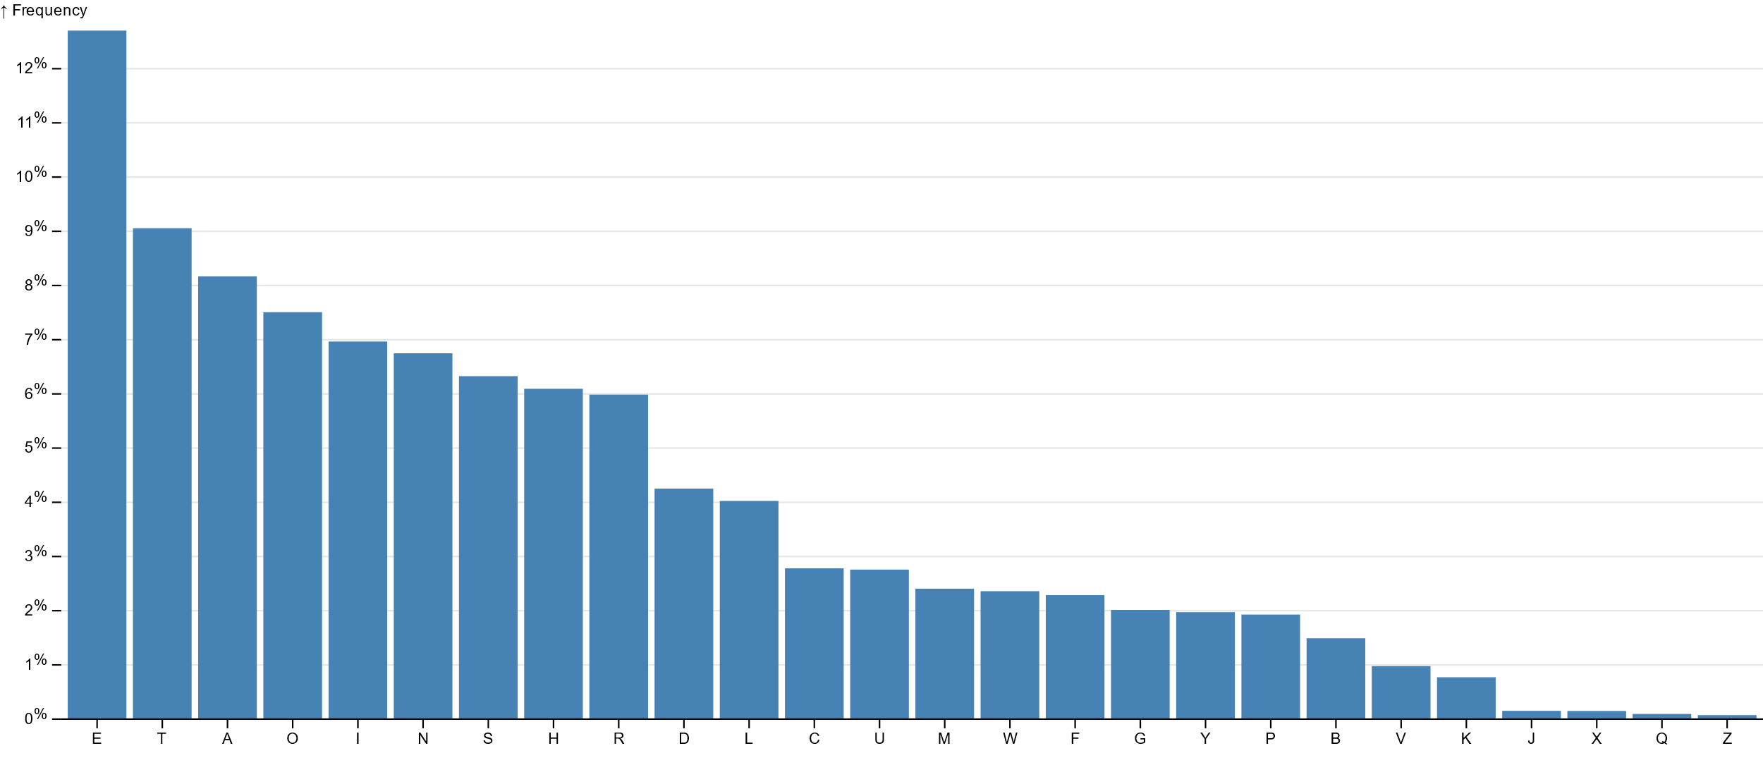
Univariate data visualization
Univariate visualizations show 1 dependent variable
https://observablehq.com/@d3/bar-chart

Slide 5
Multivariate data visualization
Multivariate visualization is concerned with showing multiple dependent variables simultaneously
For now, we focus on visualizing multiple attributes A
    Later we will add independent variables, time T and space S, and relationships R
Classes of multivariate visualization techniques
    Table-based visualizations
    Combined bi-variate visualizations
    Polyline-based visualizations
    Glyph-based visualizations
    Pixel-based visualizations
    Nested visualizations

Slide 6
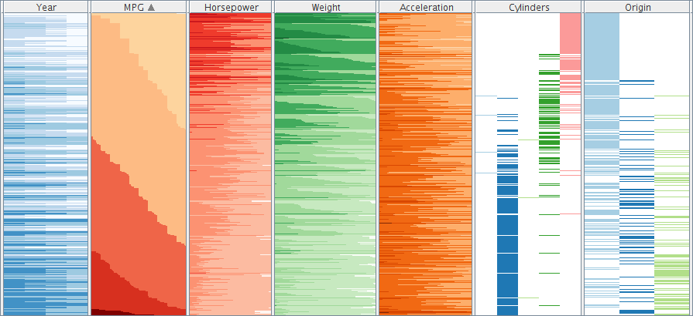
Table-based visualization
Utilize intuitiveness of tabular spreadsheets
One-to-one mapping of data table to visual table
Instead of printing
data values, employ
visual encoding in
table cells
  Color
  Bars
  Two-tone coloring

Slide 7
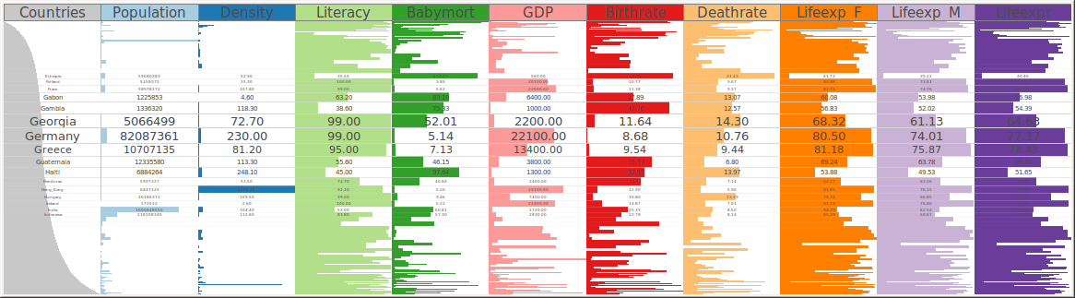
Table-based visualization
Problem: How to deal with many table rows?
Solution: Focus+context Table Lens (Rao and Card, 1994)
Recall the fisheye distortion from Lecture 4.

Slide 8
Table-based visualization
Think about: How to encode non-numeric data in table cells?
Date | Country | Nucleic acid sequence | Rating
2022-01-01 | Germany | AATCC | B+
1917-07-18 | France | AAACC | AA
2052-11-23 | Canada | GCTAG | BBB+

Slide 9
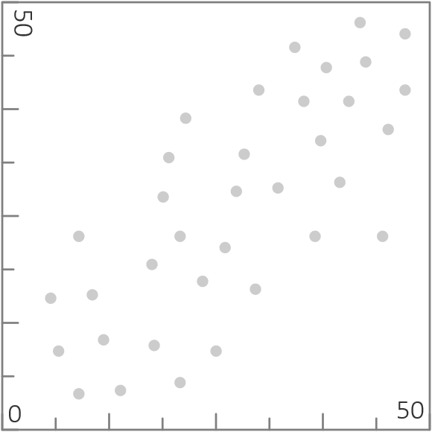
Combined bi-variate visualizations
Start with basic scatterplot
  Two axes for two attributes
  Data tuples shown as dots
Pros and cons
  Intuitive to interpret
  Over-plotting can be a problem in dense parts of the data → Unclear how many data tuples are represented by a dot (are hidden under it)

Slide 10
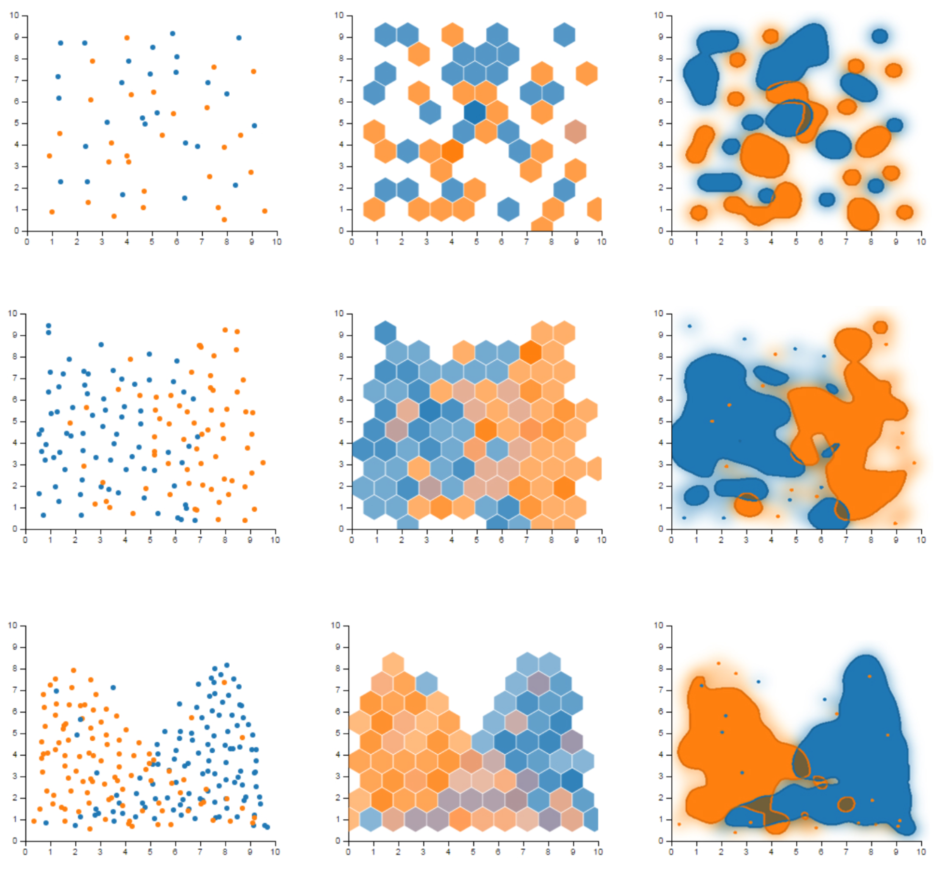
Combined bi-variate visualizations
(Sarikaya and Gleicher, 2017)
Enhancing scatterplots
  Hexagonal binning:
    Subdivide drawing space into discrete cells
    Color-code cells according to class and density information
  Splatter plots
    Extract and visualize dense parts as contours
    Smooth color gradients indicate density
    Show outliers as individual points
Scatterplot
Hex. binning
Splatterplot

Slide 11
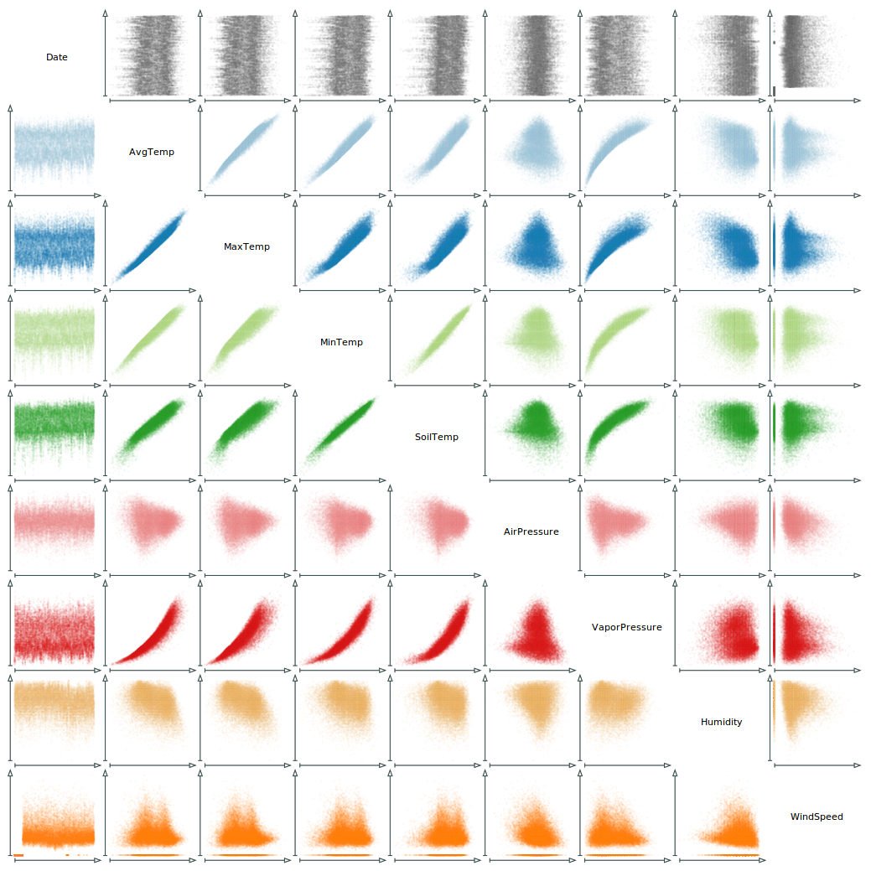
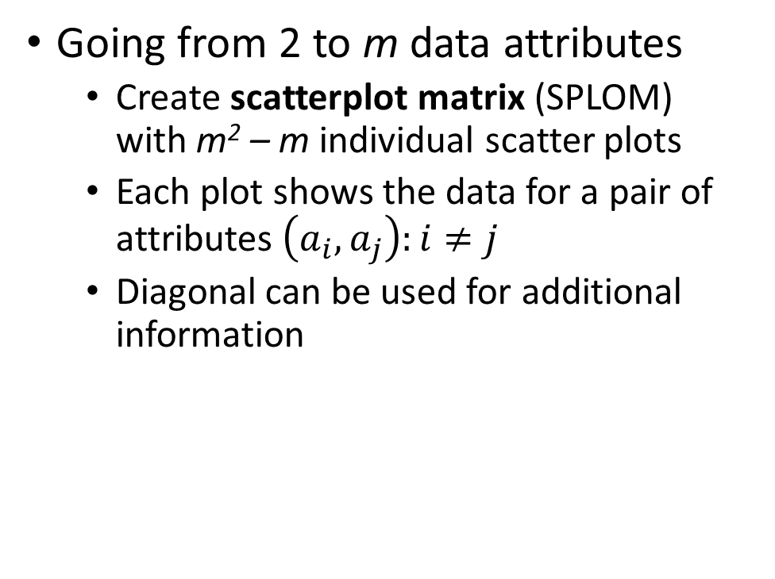
Combined bi-variate visualizations
Going from 2 to m data attributes
  Create scatterplot matrix (SPLOM)
  with m² – m individual scatter plots
  Each plot shows the data for a pair of attributes $\left(a_{i},a_{j}\right):i≠j$
  Diagonal can be used for additional information

Slide 12
Combined bi-variate visualizations
Pros and cons
  Overview of all bi-variate data relations
  Only bivariate relations visualized directly
  Analyzing true multi-variate data relations requires additional techniques (e.g., brushing & linking for tracing individual data elements across plots, see lecture on interaction)
  Reordering of matrix rows and columns might be useful
  Does not scale with very high numbers of attributes

Slide 13
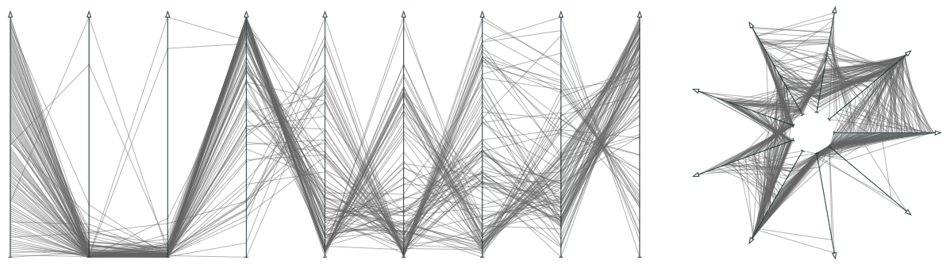
Polyline-based visualizations
Goal: Overcome separation of tuple values in
combined bi-variate visualization
Approach:
  Each attribute mapped to an axis
  Each tuple represented as a polyline that passes through the axes at points corresponding to a tuple’s data values
Polylines represent data values
Axes represent data attributes

Slide 14
Polyline-based visualizations
Different layouts of axes possible:
  Parallel coordinates (Inselberg, 2009), radial coordinates, …
A radial layout of axes also goes by the name of radar chart
Leave a gap in the center to ensure tuples with minimal values are visible.

Slide 15
Polyline-based visualizations
Pros and cons
  Advantage: Polylines make tuples explicitly visible (not just bi-variate dots)
  Otherwise, basically the same pros and cons as for combined bi-variate vis.
  Again, over-plotting can be a problem in dense parts of the data → Unclear how many data tuples are represented by a polyline segment
Think about: How to deal with over-plotting of polylines?
Notes:
Alpha-blending
Histograms

Slide 16
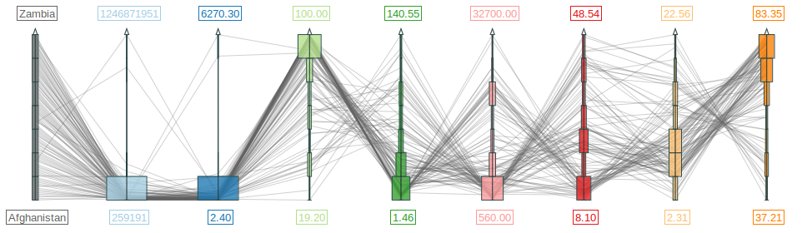
Polyline-based visualizations
Over-plotting can be dealt with by attaching histograms to the axes
Histograms visualize the data distribution for each data variable

Slide 17
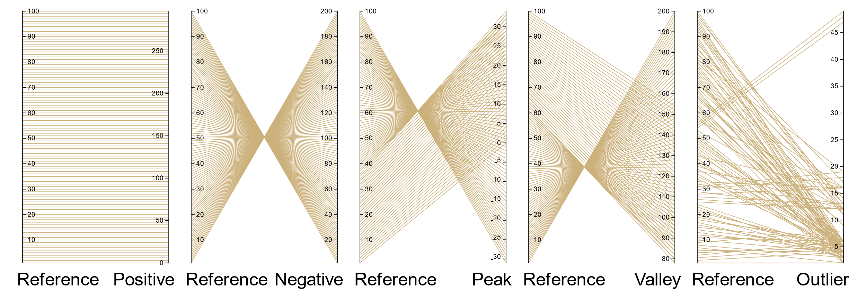
Polyline-based visualizations
Interpretation of parallel coordinates requires some training
  Think about: How would the depicted data would look like in scatterplots?

Slide 18
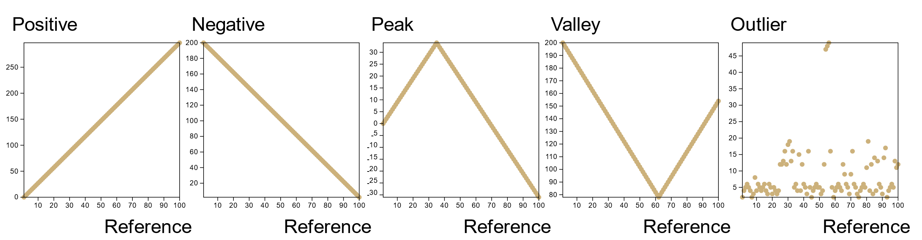
Polyline-based visualizations
Interpretation of parallel coordinates requires some training
  Think about: How would the depicted data would look like in scatterplots?
  Here is the answer:

Slide 19
Axes-based visualizations
Interesting observation: Parallel coordinates, radial coordinates, scatterplots, scatterplot matrices, line charts, all follow the same basic design pattern:
  Axes: Define how data variables are mapped to display positions
    Simple axis, scroll axis, focus+context axis, hierarchical axis, …
  Axes arrangement: Defines how axes are laid out on the display
    Parallel coordinates, scatterplot matrix, radial coordinates, etc.
  Data drawing: Defines how data tuples are drawn
    Open polyline (par. coord.), closed polyline (radial coord.), dots (scatterplot), connected dots (line chart)
→ Family of visualization techniques: Axes-based visualization

Slide 20
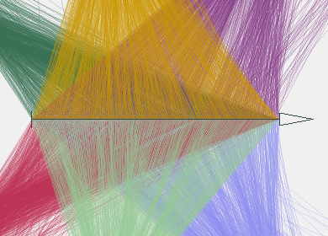
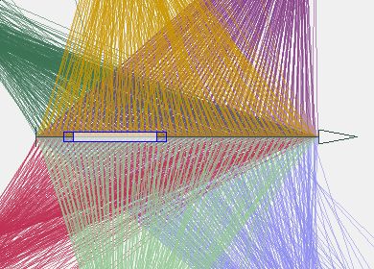
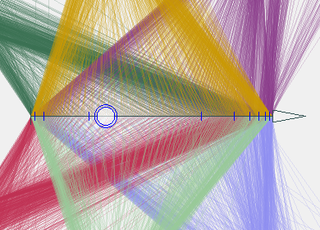
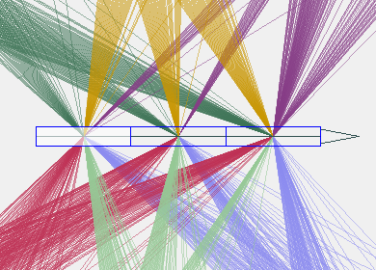
Axes-based visualizations
Different types of axes
  Simple axis
  Scroll axis
  Focus+context axis
  Hierarchical axis

Slide 21
Axes-based visualizations
Abstractly modelled via attribute relation graphs of interest (ARGoI)
(Claessen and van Wijk, 2011)

Slide 22
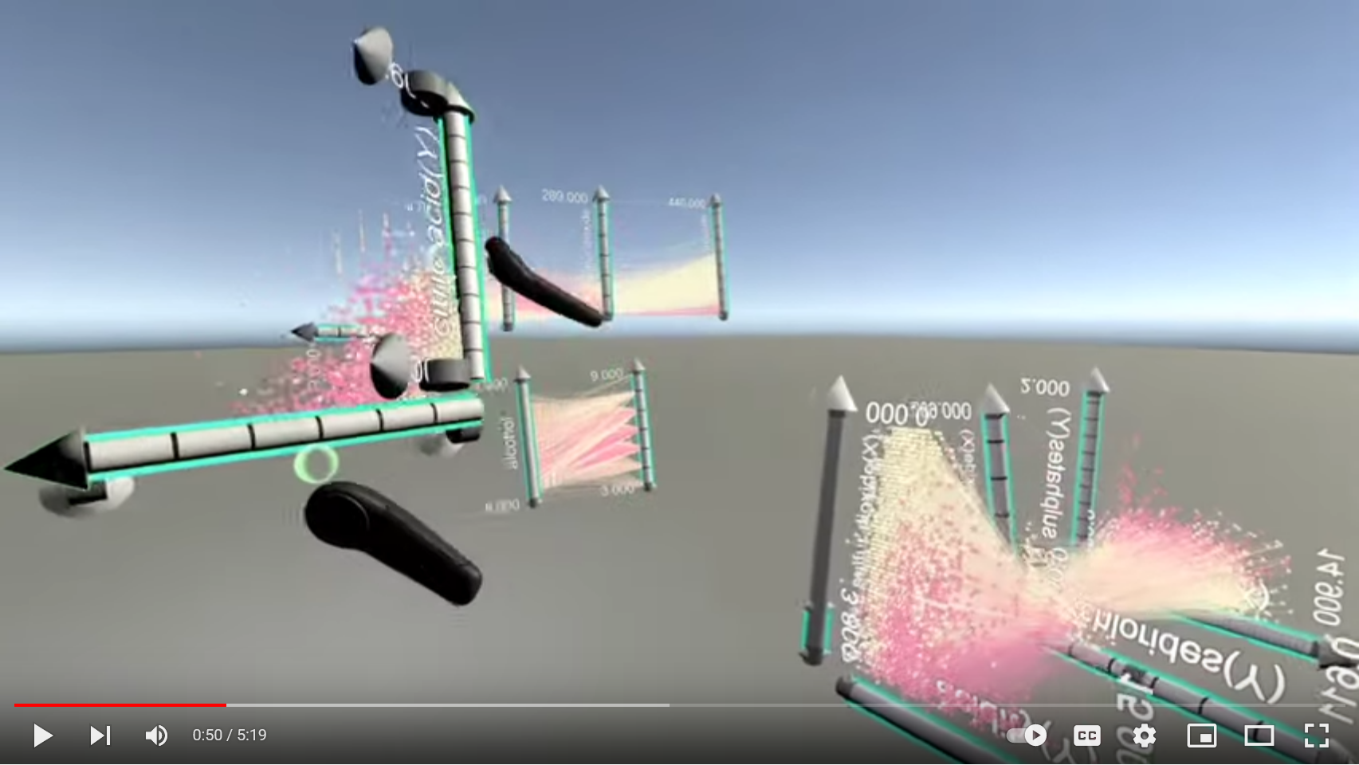
Axes-based visualizations
Axes-based
visualization
in VR
https://www.youtube.com/watch?v=hxqJJ934Reg

Slide 23
Glyph-based visualizations
Goal: Represent data tuples as coherent self-contained visual units
Characteristics of glyphs:
  Can represent multiple data attributes
  Can be arranged on the display
Setting up a glyph-based visualization requires three steps:
  Glyph design
  Attribute-to-glyph mapping
  Glyph placement

Slide 24
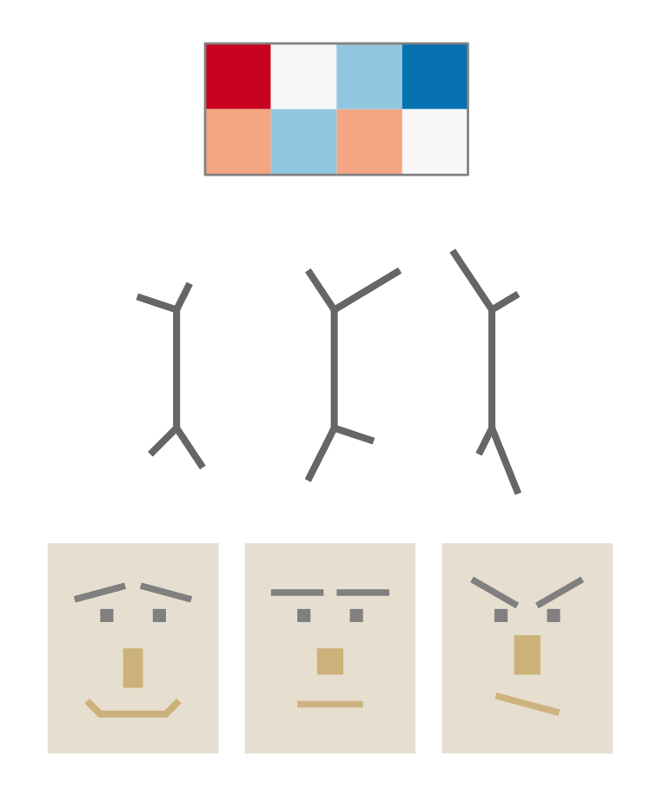
Glyph-based visualizations
Glyph design
  Challenging due to limited display space
  Design questions:
    How many attributes should be represented?
    How many data values should be discernible per attribute?
    How to combine the different attributes and encodings?
  Examples:
    Autoglyph with color-coded grid cells
    Stick figures vary length, thickness, color, and angle of limbs
    Chernoff faces vary features of human face

Slide 25
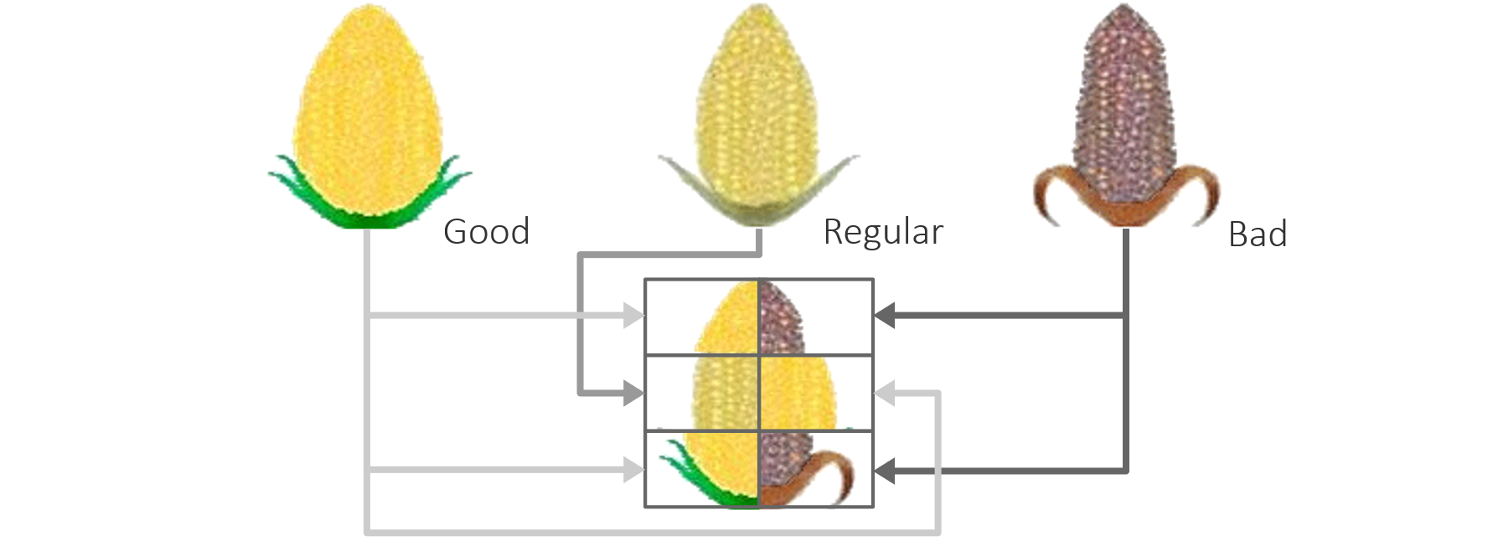
Glyph-based visualizations
Attribute-to-glyph mapping
  Typically requires reducing value ranges to a low number of distinguishable values (or classes)
  Example: Corn glyph
    Data values first mapped to
    ordinal scale: good, regular, bad
    Ordinal values then mapped to three
    pictorial corncobs: magnificent, normal, withered
    Six factors influencing the corn harvest mapped
    to six segments of the corn glyph

Slide 26
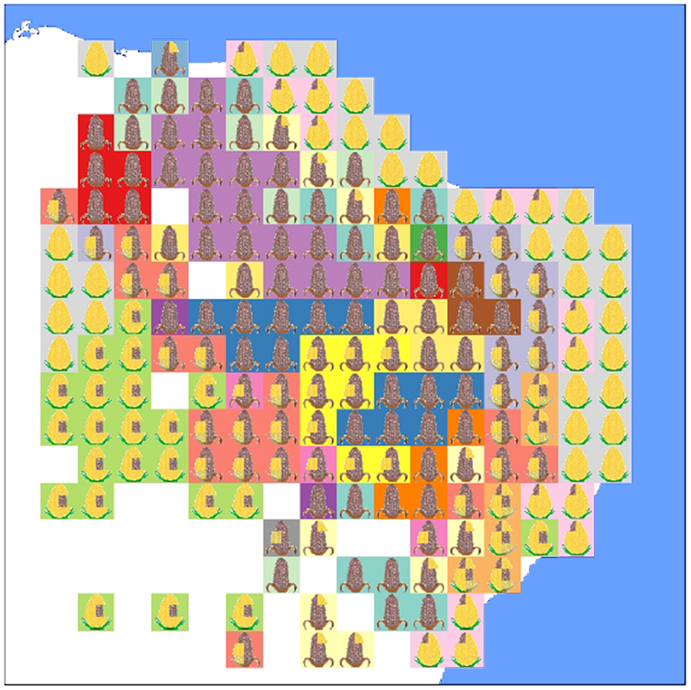
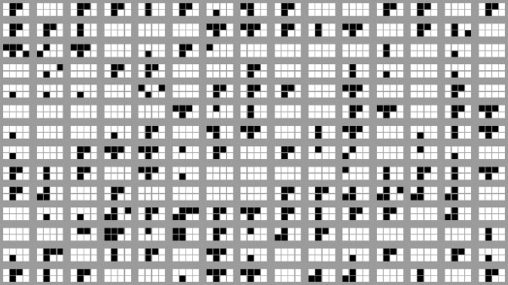
Glyph-based visualizations
Corn glyphs representing farming conditions in the north-east of Brazil
Glyph arrangement
  Important for communicating overview
  Different options:
    Regular grid,
    Geo-positions
    …
Autoglyphs representing bacteria resistance arranged on a regular grid

Slide 27
Overview
Visualization techniques for multivariate data
  Table-based visualizations
  Combined bi-variate visualizations
  Polyline-based visualizations
  Glyph-based visualizations
  Pixel-based visualizations
  Nested visualizations

Slide 28
Pixel-based visualizations
“Minimalistic” approach to visualization
Data values represented by color of individual pixels
Low space requirements → Visualize millions of data values
Design steps:
  Decide for an appropriate color mapping
  Decide where to show pixels of different attributes
  Decide how to arrange pixels per attribute

Slide 29
Pixel-based visualizations
Decide for an appropriate color mapping
  Single pixel colors are difficult to discern
  Color-contrast effect influences perception
  Choose color scale with well-distinguishable colors
Decide where to show pixels of different attributes
  Separation: Show individual attributes in different views
  Integration: Show several attributes in same view (similar to autoglyph)

Slide 30
Pixel-based visualizations
Decide how to arrange pixels per attribute
  Element-wise: Ordered as in data
  Pre-determined: Ordered based on independent variable
  Attribute-based: Ordered based on attribute values
  Query-based: Ordered based on distance to query

Slide 31
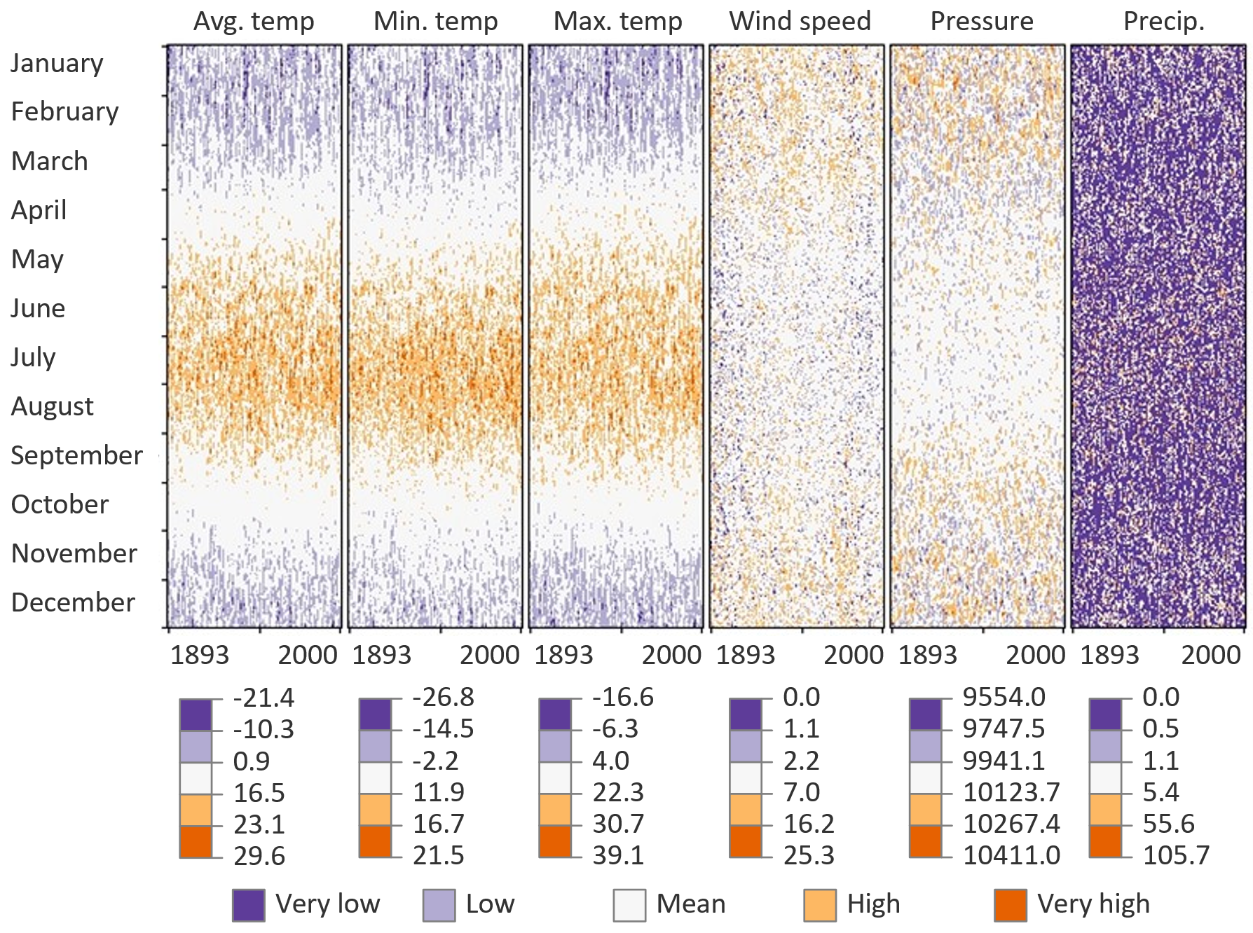
Pixel-based visualizations
Example: Meteorological data
  Diverging color map with only 5 colors
  Separation of pixels into distinct rectangular regions
  Ordering by dimension of time
Pixel-based vis. are well suited for generating overviews of multivariate data!

Slide 32
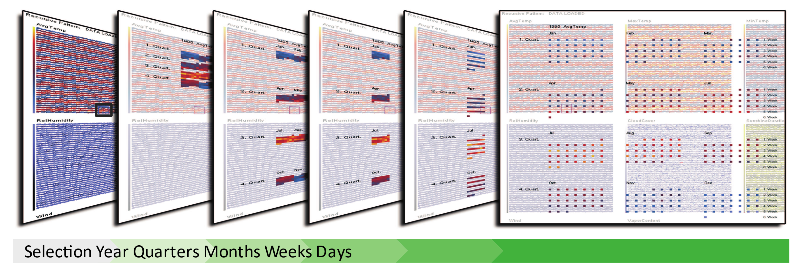
Pixel-based visualizations
Interpreting pixel-based visualizations
  Explode to explain: Staged animation to drill down into individual pixels
  Example shows explosion of selected data of interest w.r.t. time
(Luboschik and Schumann, 2007)

Slide 33
Nested visualizations
Visualize multivariate relationships by visually nesting
subsets of data attributes
Suitable for nominal and ordinal attributes and discrete attributes with low cardinality (few distinct values)
Nesting involves several steps
  Define attribute subsets
  Define nesting order
  Embed subsets within subsets

Slide 34
Nested visualizations
Define attribute subsets
    Define k subsets of attributes, each subset is of fixed size s
Define nesting order
    Nesting order determines visibility of attributes
    Top-ranked attributes are prominent whereas lower-rank attributes are subordinate
Examples:
    k = 3, s = 1 → (a1), (a2), (a3)
    k = 4, s = 2 → (a1, a2), (a3, a4), (a5, a6), (a7, a8)

Slide 35
Nested visualizations
Embed subsets within subsets
  Different techniques for subsets of different size s
    s = 1 → Mosaic plot
    s = 2 → Dimensional stacking
    s = 3 → Worlds within worlds

Slide 36
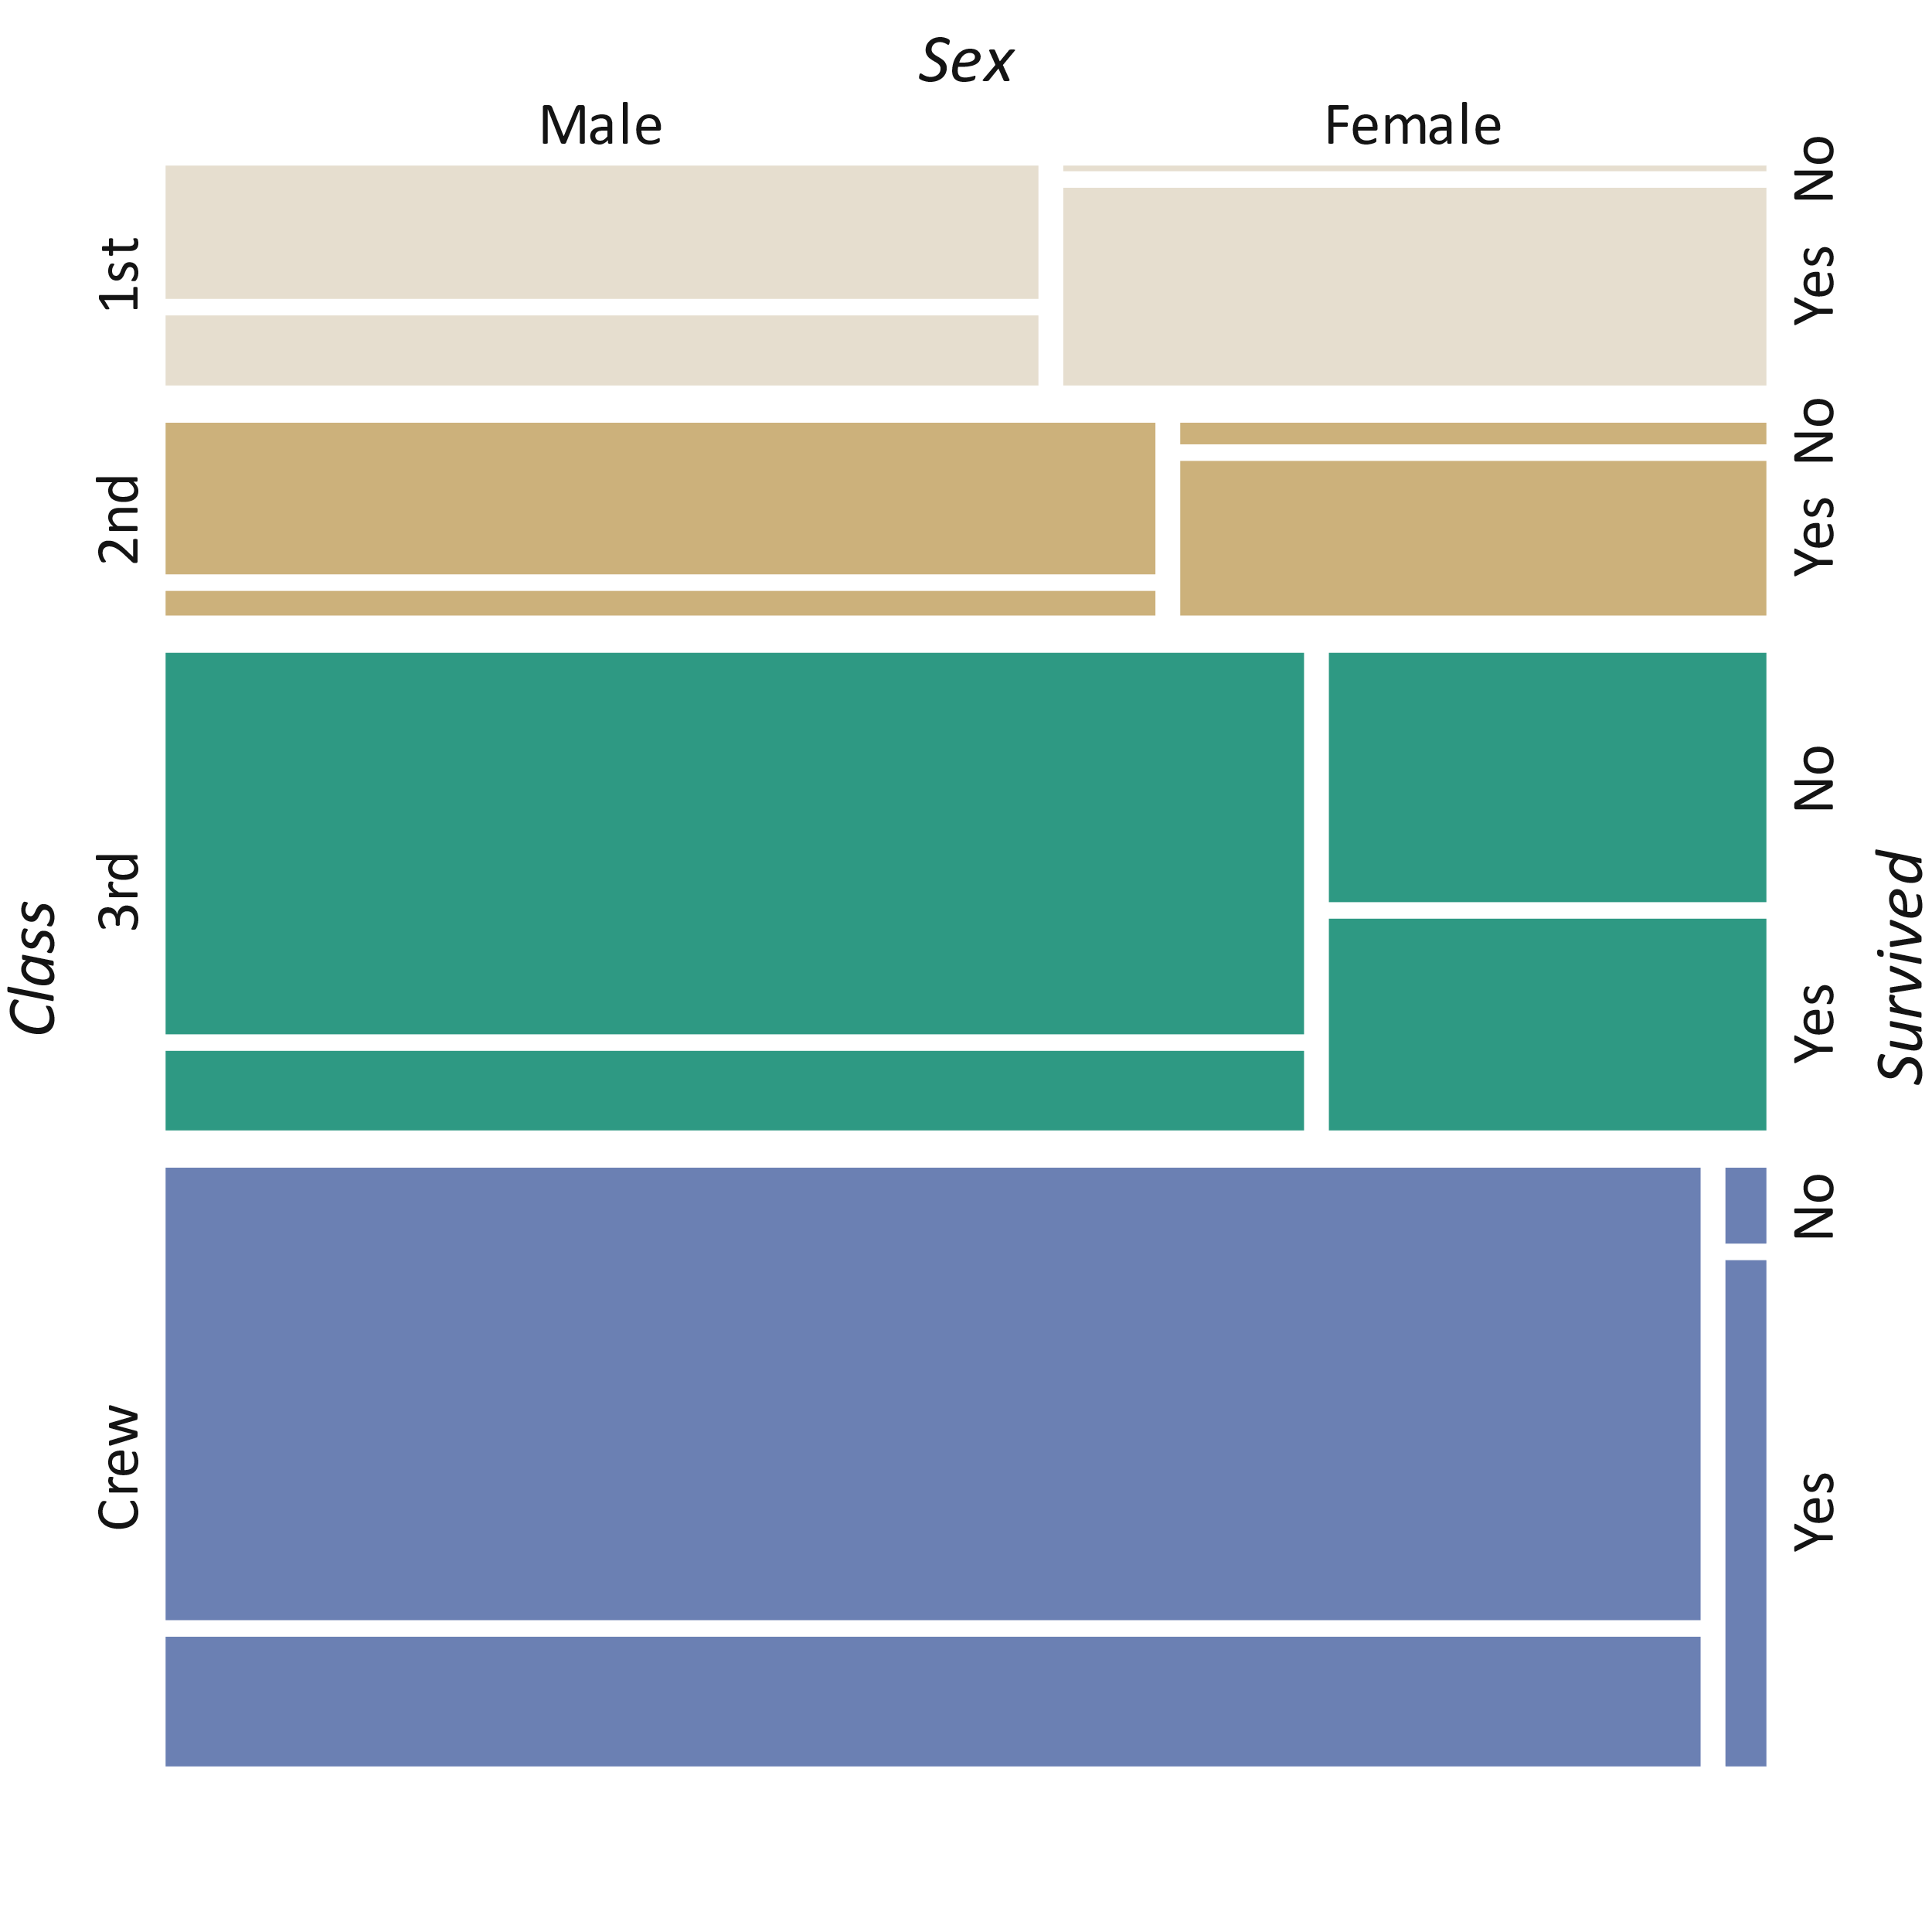
Nested visualizations
Titanic survival data
a1: Class
a2: Sex
a3: Survived
Mosaic plot (a1), (a2), (a3), …
  Basic idea: Repeatedly split rectangles so that their size is proportional to value frequency while alternating split axes
    Split display area along vertical axis into rectangular segments according to the distinct values of a1’s domain, segment size corresponds to frequency of data tuples per distinct value
    Split rectangular segments again, but this time along the horizontal axis according to a2
    Switch axes and split along vertical axis, this time according to a3
    …

Slide 37
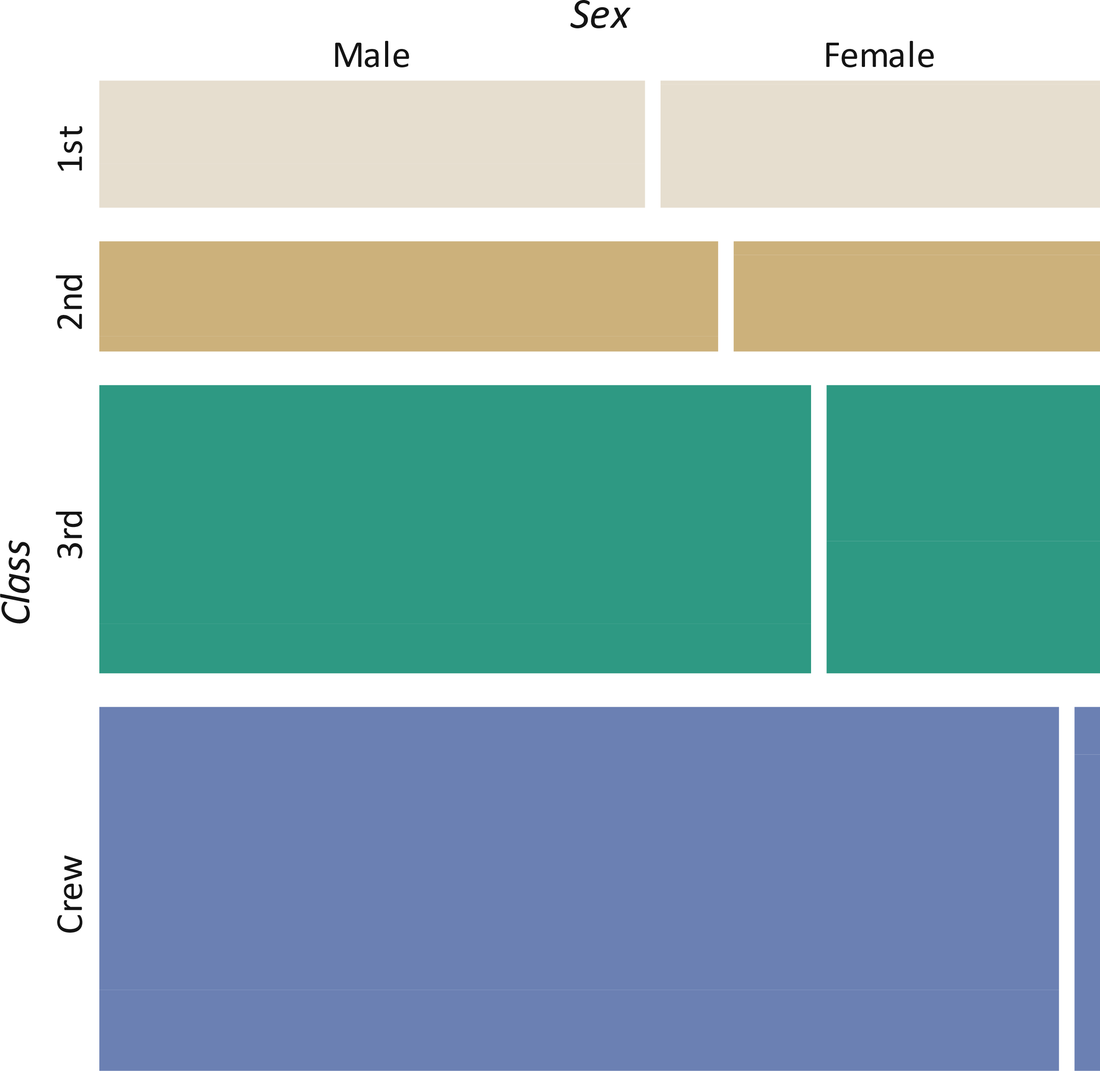
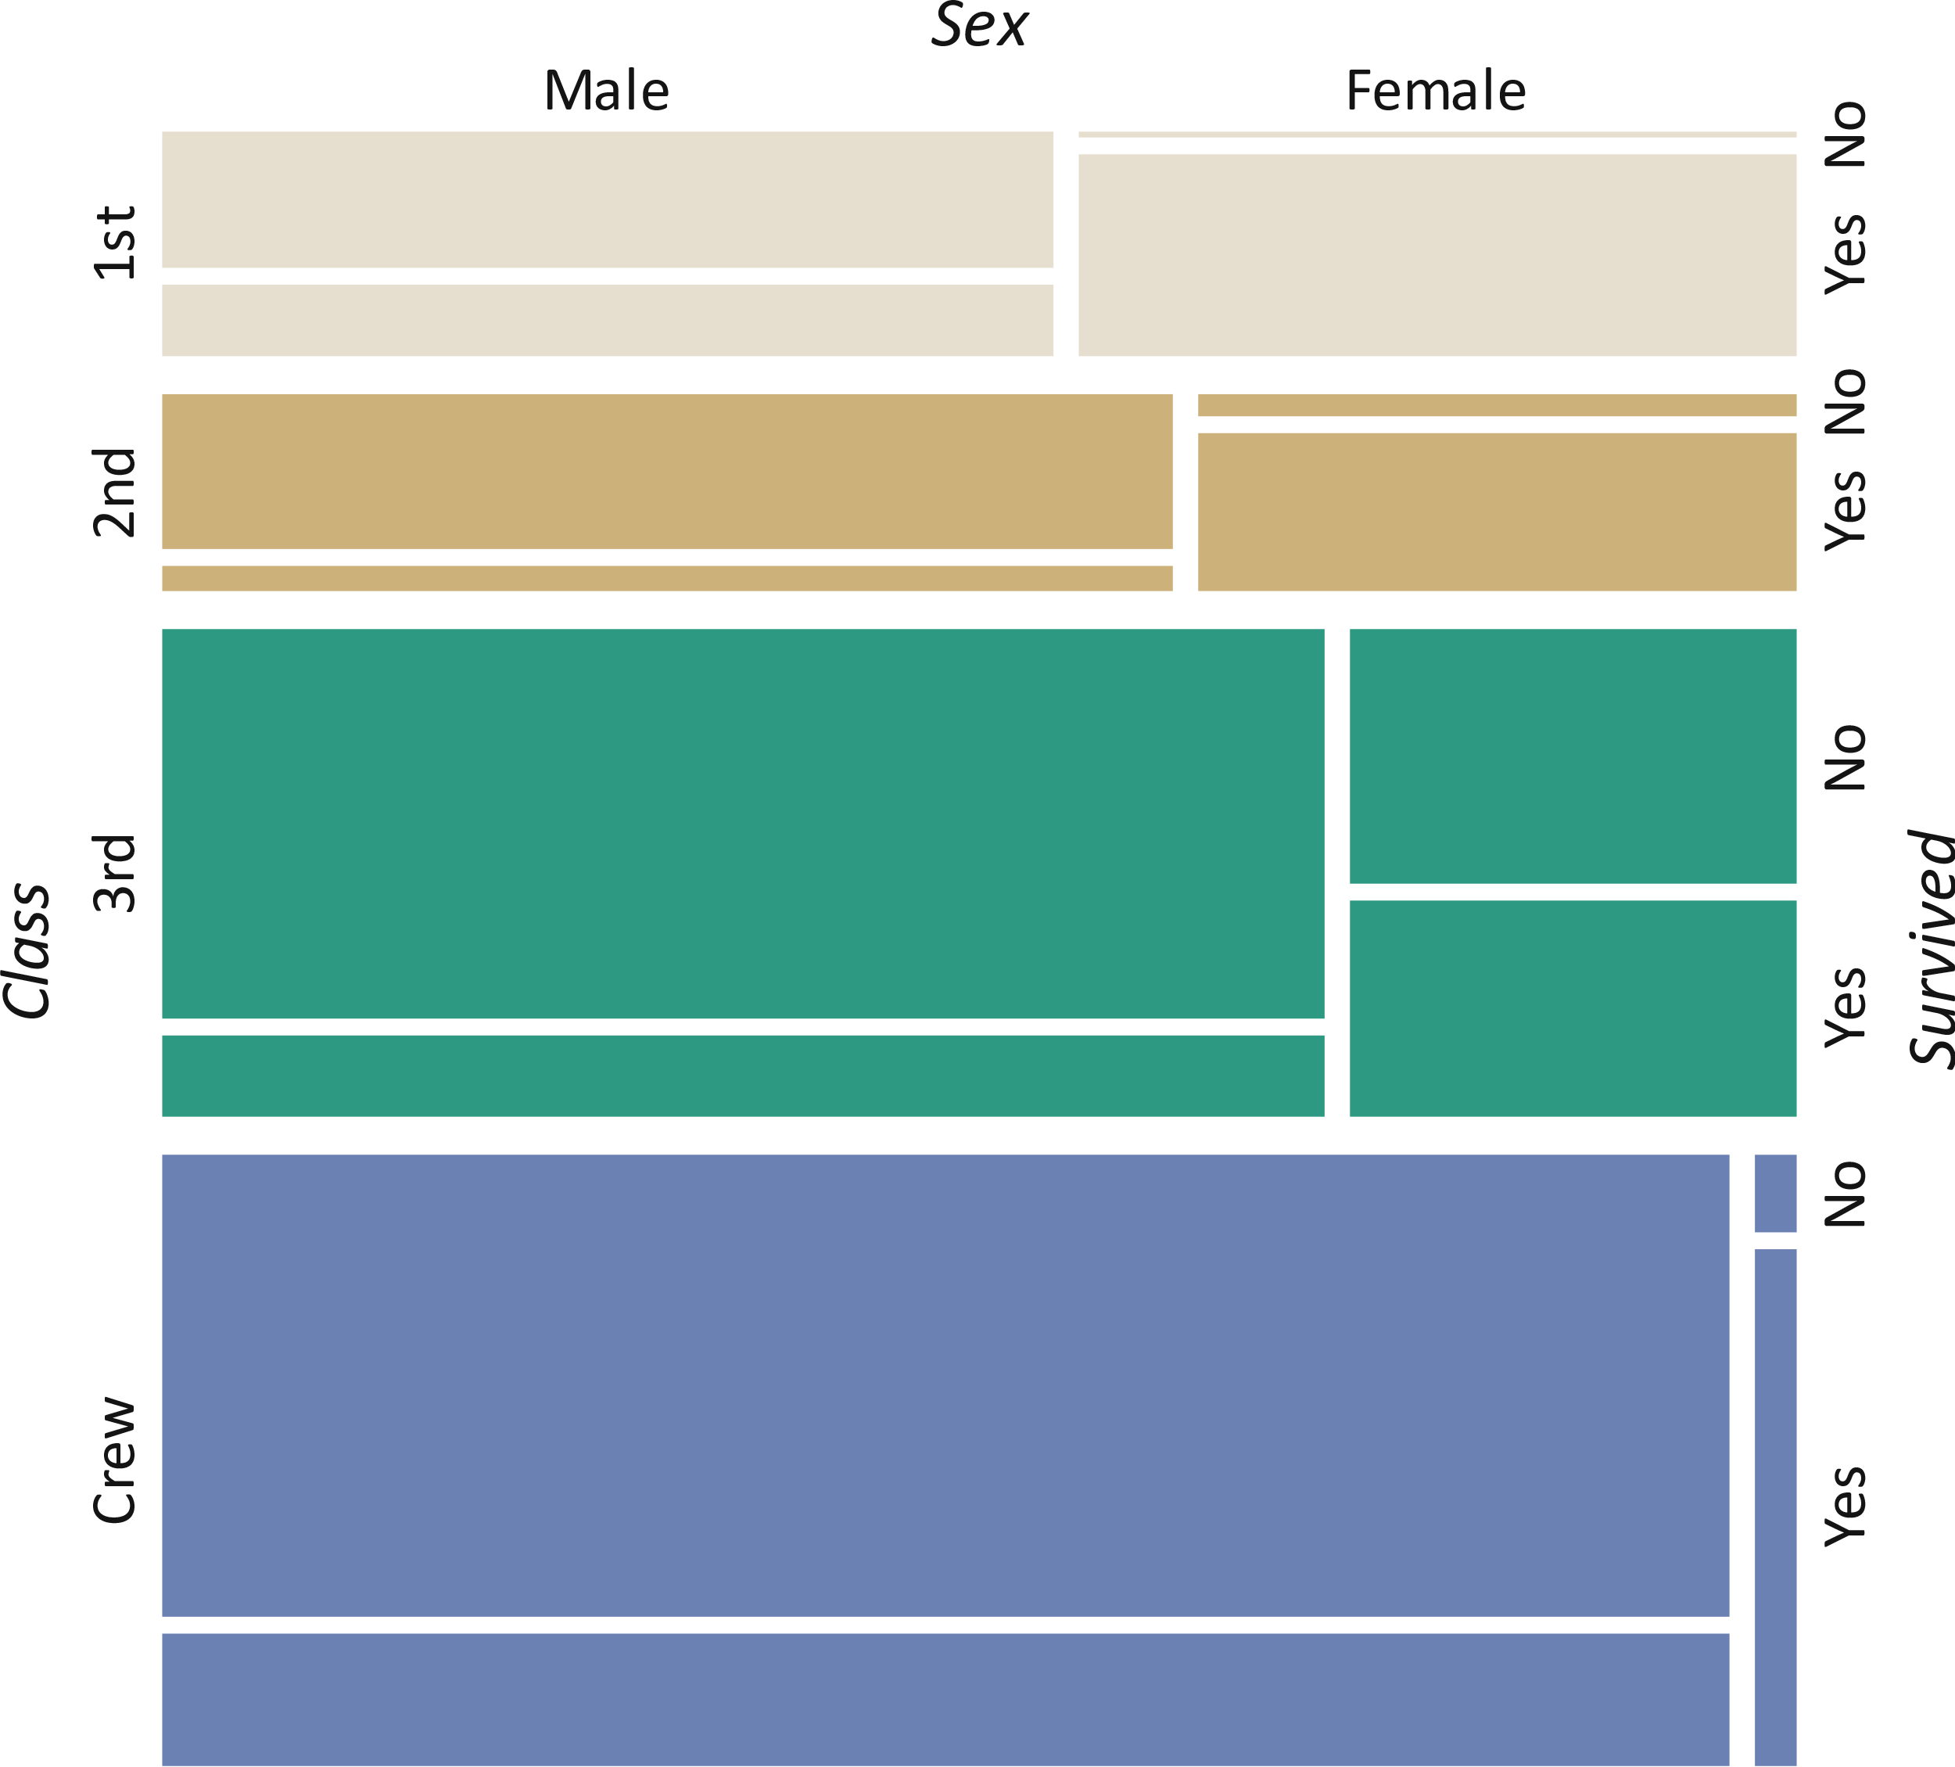
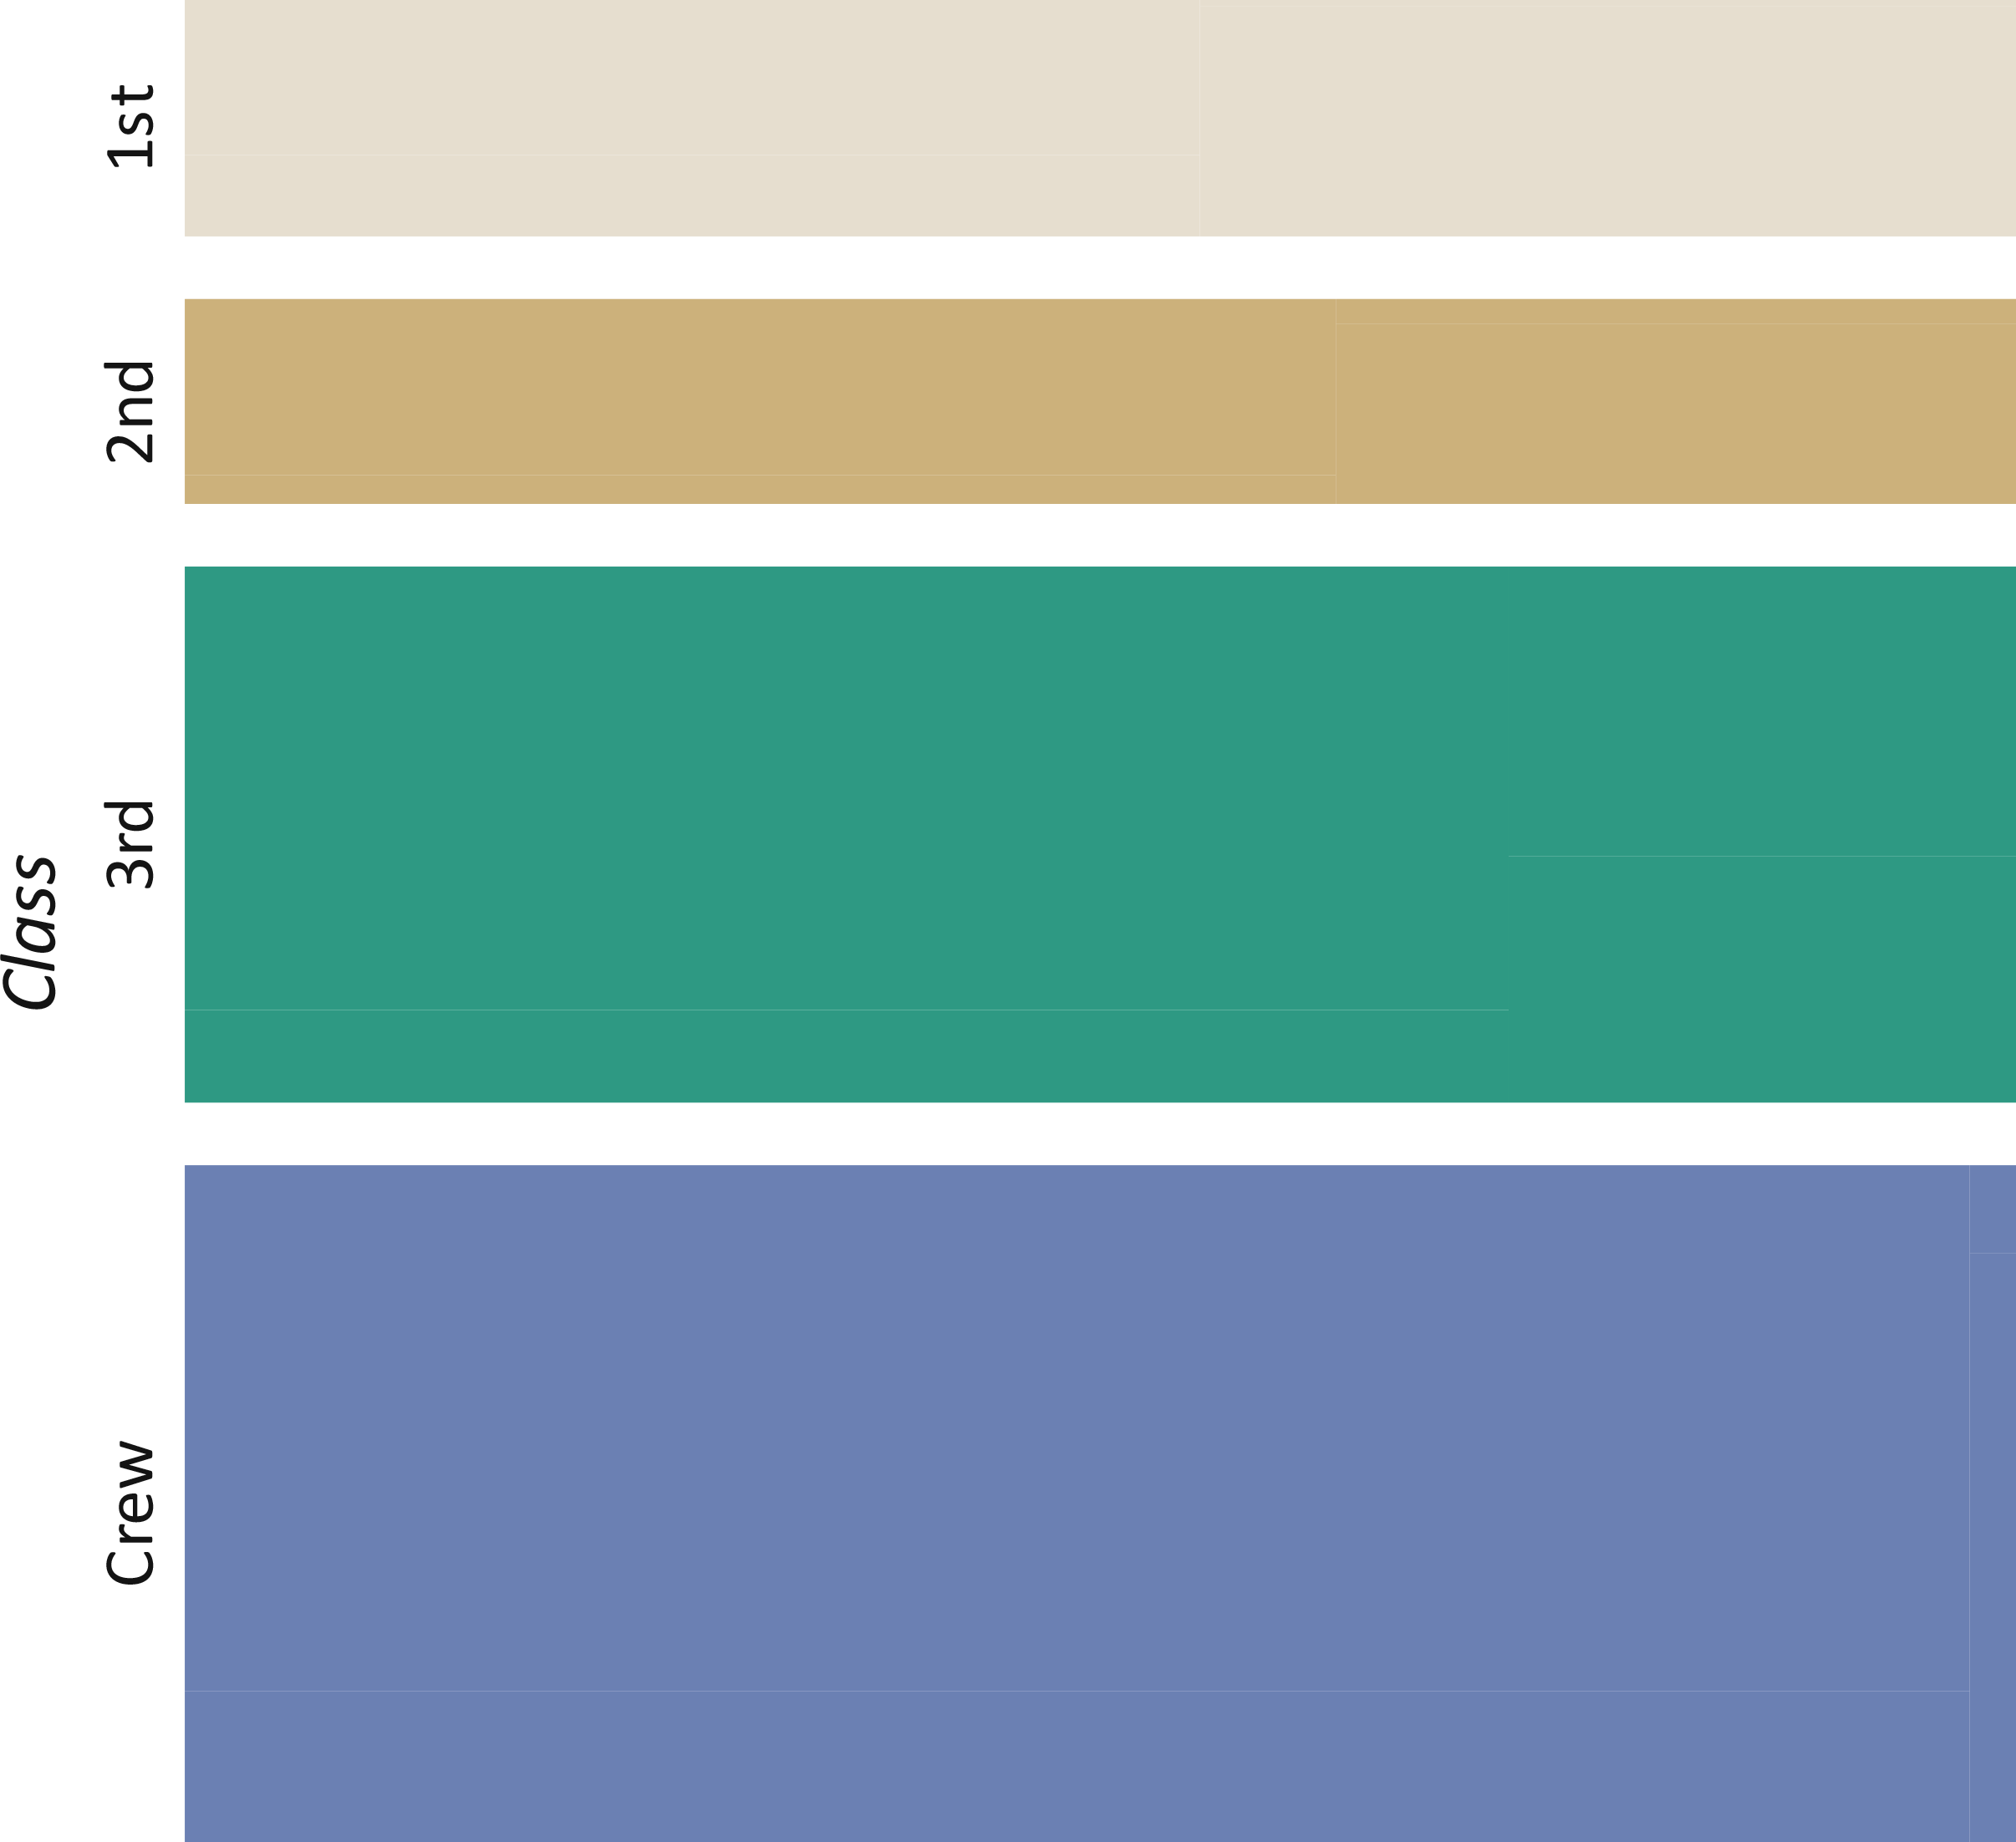
Nested visualizations
Mosaic plot (a1), (a2), (a3), …
  Illustration of splitting procedure (a1: Class, a2: Sex, a3: Survived)

Slide 38
Nested visualizations
Dimensional stacking (a1, a2), (a3, a4), (a5, a6), (a7, a8), …
  Basic idea: Embed grids within grids
    Split display area into |a1| x |a2|
    Split each created grid cell into a new
    |a3| x |a4| grid
    Split each of these cells into new
    |a5| x |a6| grids
    …
  Color-code cells according to frequency
  of tuples exhibiting a cell’s
  value combination

Slide 39
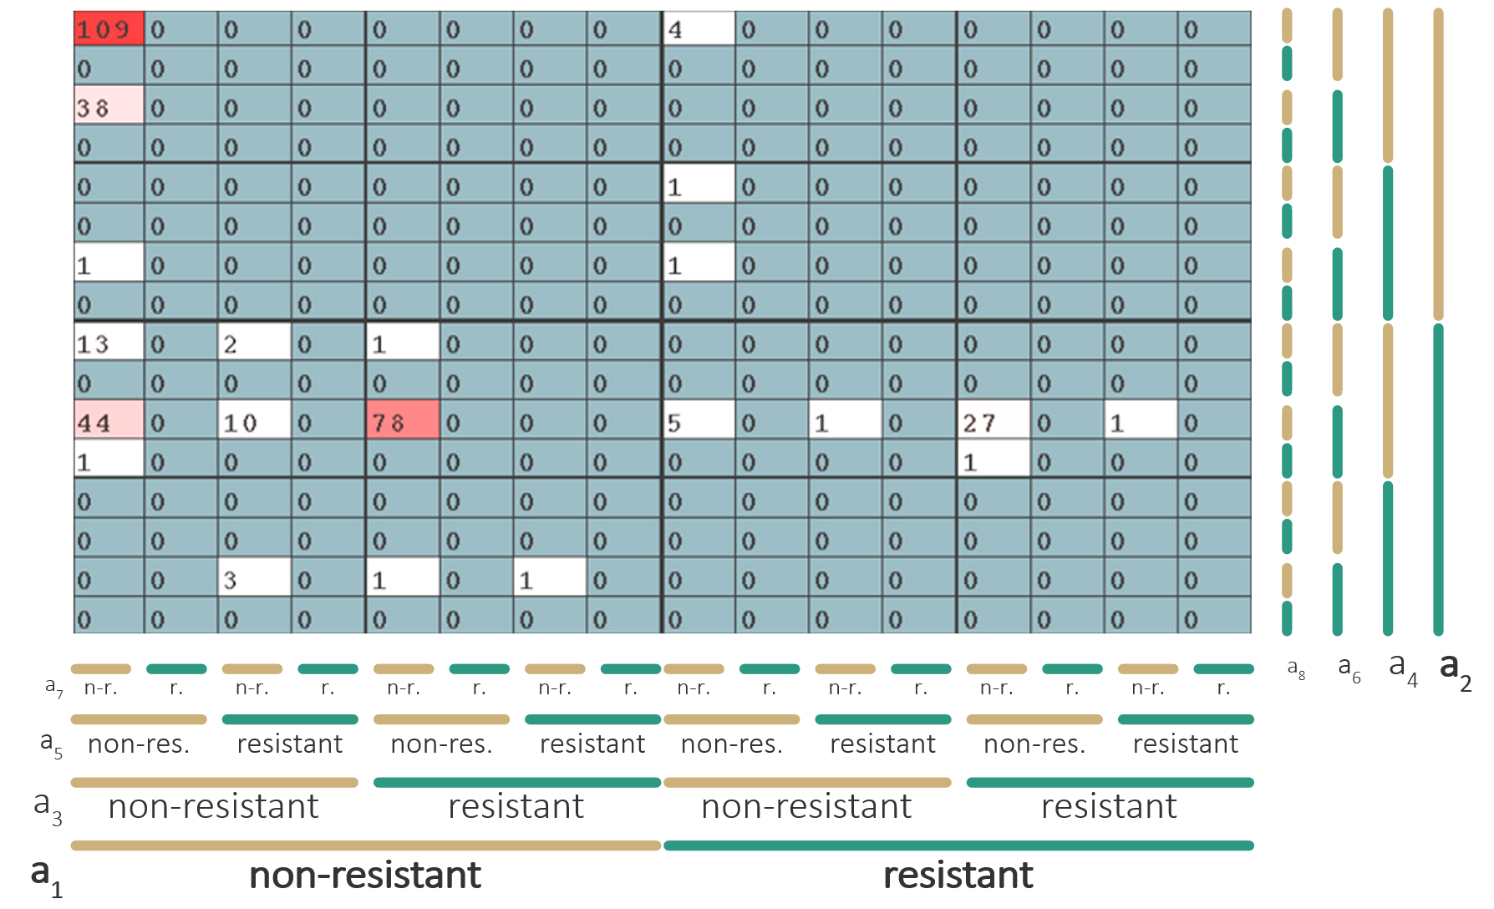
Nested visualizations
Bacteria resistance against 8 antibiotics
Dimensional stacking (a1, a2), (a3, a4), (a5, a6), (a7, a8), …
Bacteria resistance
against 8 antibiotics a₁ to a₈
Each a_{i} has two values
  Resistant
  Non-resistant

Slide 40
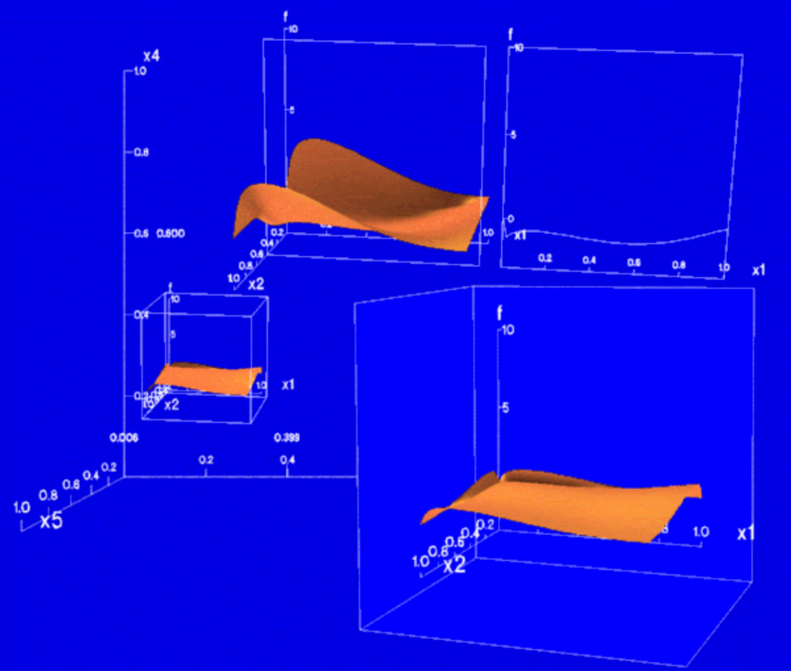
Nested visualizations
Worlds within worlds (a1, a2, a3), (a4, a5, a6), (a7, a8, a9), …
  Basic idea: Nest 3D coordinate systems
    First coordinate system defined by (a1, a2, a3)
    User selects fixed point
    Embed at selected point a new coordinate system for (a4, a5, a6)
    Again, selected a fixed point
    …
  Data tuples are plotted only in the last generated
  coordinates system
    Data directly visualized only w.r.t. three attributes
    All other attributes implicitly defined through nesting order
Feiner & Beshers, 1990
Notes:
Figure source: https://citeseerx.ist.psu.edu/viewdoc/download?doi=10.1.1.130.90&rep=rep1&type=pdf

Slide 41
Nested visualizations
Pros and cons
  Nesting is a powerful mechanism to deal with multiple variables
  Nesting not trivial to construct
  Interpreting nested visual representations requires some training

Slide 42
Multivariate data visualization
Summary
Table-based vis.
  Enhance common spreadsheets to visual representations
  Sorting table rows allows us to detect correlations, outliers, and clusters
  With the help of focus+context one can read values precisely
Combined bi-variate vis.
  Suited to communicate two-dim. value distributions, bivariate correlations, clusters, and outliers
  Multivariate relationships can be studied with additional
  means (e.g., brushing & linking)
  Data frequency can be revealed with additional means (e.g., alpha-blending)

Slide 43
Multivariate data visualization
Summary
Polyline-based vis.
  Visualize entire data tuples as polylines
  Exploration of attributes of neighboring axes well supported
  Exploring all attribute relations requires axes re-ordering
  Data frequency can be revealed with additional histograms
Glyph-based vis.
  Data tuples encoded as small glyphs
  Goal is to provide an overview at the cost of omitting details
  Can be applied for data with spatial frame of reference (see Lecture 7)

Slide 44
Multivariate data visualization
Summary
Pixel-based vis.
  Each data value visualized by single colored pixel
  Very space-efficient, can visualize very large datasets
  Details can be made visible with additional means (e.g., view explosion)
Nested vis.
  Recursive embedding of attribute subsets on the display
  Well suited to visualize frequencies (counts) for qualitative value combinations
  Powerful approach, but not so easy to interpret

Slide 45
Assignments
Read “Scatterplots: Tasks, Data, and Designs” by Sarikaya and Gleicher!
Explore visualization techniques for multivariate data at https://datavizcatalogue.com/!
Experiment with multivariate visualizations on Observable!
  https://observablehq.com/@d3/splom
  https://observablehq.com/@d3/parallel-coordinates

Slide 46
Questions
Name different visualization approaches for multivariate data!
What are parallel coordinates plots?
What can we see in parallel coordinates plots and what not?
How does a given pattern from a parallel coordinates plot look like as a scatterplot?
How can scatterplots be enhanced to show the frequency of data points?
What is the general idea behind axes-based visualization?
Why are glyph-based visualizations particularly difficult to design?
What is an advantage of pixel-based visualization?
How are mosaic plots created?
What are the pros and cons of nested visualization?

